Slide 1
Coursera Capstone
IBM Applied Data Science Capstone
Where to Set-Up Shop in Los Angeles?
Joseph Kenrick 1/5/2020

Slide 2
Introduction
Business owners deciding where to set up a new restaurant or shop is one of the most important decisions that will determine whether the venue will be a success or a failure.
Objective: To analyze and select the best locations in the city of Los Angeles, California to open a new Mexican Restaurant and a new Coffee Shop.
Business question: In the city of Los Angeles, if a property developer is looking to open a new Mexican Restaurant or Coffee shop, where would you recommend them to open it?

Slide 3
Data
Based on the definition of our problem, factors that will influence our decision are:
  number of existing restaurants in the neighborhood (any type of restaurant)
  number of, and distance to, Mexican restaurants or Coffee Shops in the neighborhood, if any
  distance of neighborhood from city center
Sources of data:
  https://www.zipdatamaps.com/list-of-zip-codes-in-california.php
  Geocoder package for latitude and longitude
  Foursquare API for venue data

Slide 4
Methodology
Web scraping zipmaps page for neighborhoods list
Get latitude and longitude coordinates using Geocoder
Use Foursquare API to get venue data
Group data by neighborhood and taking the mean of the frequency of occurrence of each venue category
Find cluster best suited for Mexican Restaurant and cluster for Coffee Shop
Find neighborhood closest to city center within the cluster
Visualize the clusters and chosen neighborhoods in a map using Folium

Slide 5
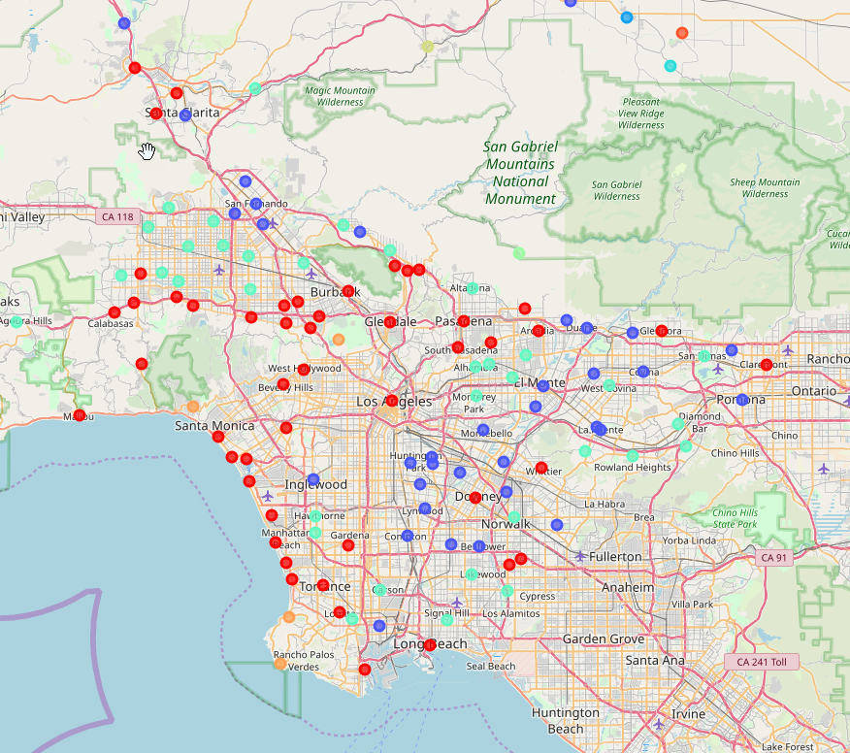
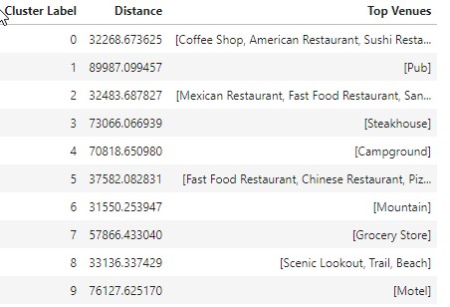
Analysis
The red cluster indicates cluster 0, which was
determined to be the cluster for the Coffee Shop
The dark blue cluster indicates cluster 2, which
was determined to be the cluster for the Mexican
Restaurant

Slide 6
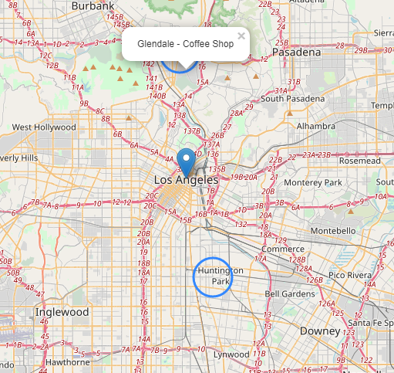
Results
There are neighborhoods with high concentrations of Mexican Restaurants and Coffee Shops all over Los Angeles County, but by considering distance to the Los Angeles City center, and thus the high tourist areas with ease of public transportation, we were able to find the best neighborhoods for each shop. Glendale for the Coffee Shop, and Huntington Park for the Mexican Restaurant.

Slide 7
Conclusion
Purpose of this project was to identify Los Angeles areas close to center with high number of venues (particularly Mexican restaurants and Coffee shops) in order to aid stakeholders in narrowing down the search for optimal location for a new restaurant/shop. Clustering of those locations was then performed in order to create major zones of interest (containing greatest number of potential locations) and then to be used as starting points (Cluster 0 and Cluster 2) for exploration by stakeholders. By clustering neighborhoods by restaurant distribution from Foursquare data we have first identified general boroughs that justify further analysis.
Final decision on optimal restaurant location was based on location to city center to indicate neighborhoods on convenient access and higher traffic.

